Slide 1
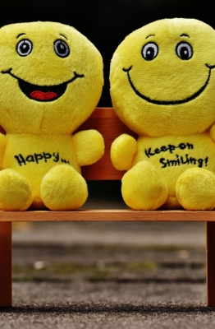
Life?
.
Presented by:

Slide 2
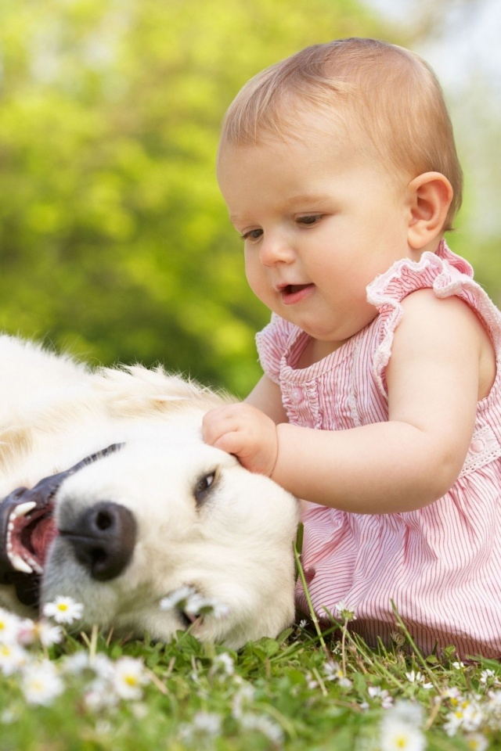
The questions of life
What is the meaning of life?
Why do we need to recreate?
Does death have any meaning?
Did the universe really begin with Big Bang Theory?
Does my experience crowds my judgment?
The Big question
Does personal experience affect our perception?

Slide 3
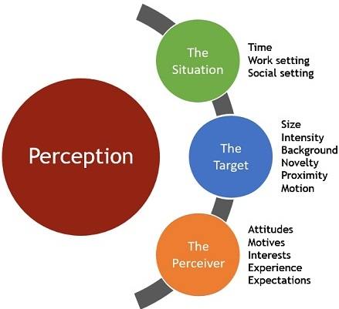
Perception
Does Past experience Affects;
Our ideas and thoughts
Our actions?
Behavior
Cognition
Independence
Do we have the right to judge others?
Based on our different experiences that affected our ideas, thought process and actions, what right do we have in judging others?

Slide 4

My life
Dogs Gaze Cumulative Accuracy T-test
Has my past distorted my perception to life?
How do I view life?
How do I perceive art especially music?
Would my preferences changed if I lived in 18th century?
Doe my religion affects the way I see life and take life?
Has my culture clouded my judgment?
Difference Scores Calculated in Ostensive and Nonostestive Conditions for Different Measures of Gaze Following

Slide 5
References
Boden, M. A., Feldman, F., Fischer, J. M., Hare, R., Hume, D., Joske, W. D., ... & Luper, S. (2016). Life, death, and meaning: Key philosophical readings on the big questions. Rowman & Littlefield.
The End

